Slide 1
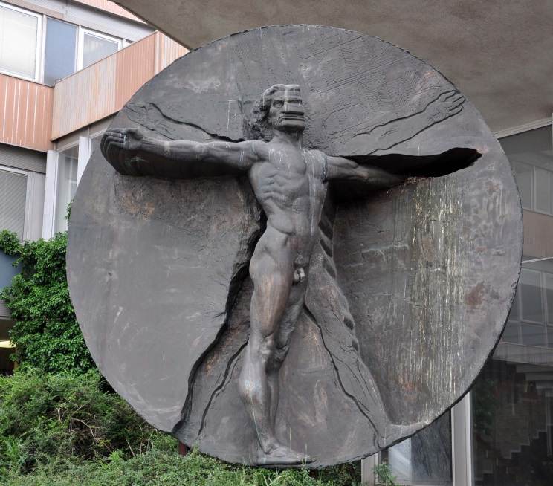
MediTec – 1st Coordination Meeting 22nd - 24th February 2018 Amman, Jordan

Slide 2
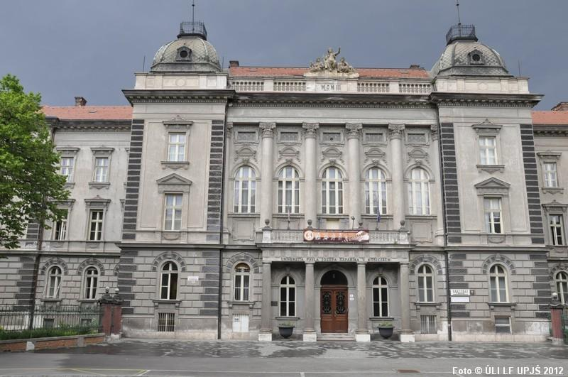
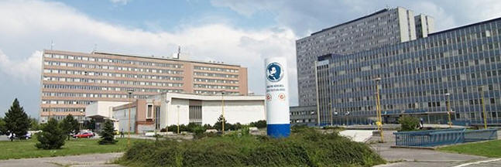
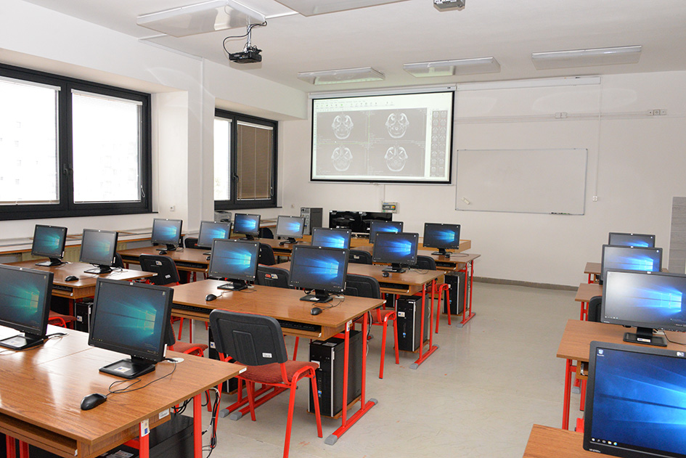
Pavol Jozef Šafárik University in Košice
the second oldest classical university in Slovakia
founded as UNIVERSITAS CASSOVIENSIS in 1657
established Pavol Jozef Šafárik University in Košice in 1959
5 faculties: Medicine, Science, Law, Public Administration and Arts
Faculty of Medicine at UPJŠ in Košice
11 years older than University (1948, UK in Bratislava)
Bc., Mgr.: Nursing Care, Physiotherapy, Public health
Dr.: General and Dental medicine (SK/EN, 2 640 students)
PhD. and specialization study
more than 60 departments and clinics
students from over 40 countries
more than 12 500 graduates
Department of Medical Informatics
since 1990 – first computer classroom
Medical Informatics, Evidence Based Medicine, Biostatistics, IS in Medicine, Computer Biometrics ...
eLearning, telemedicine, videoconferences, human motion analysis, statistical evaluation of experimental data, virtual patients, eAssessment, …
The key mission of Pavol Jozef Šafárik University in Košice is to provide higher education based on the newest scientific findings in a wide international context, following the European trends and goals laid down in the Bologna Declaration and other documents.
UPJŠ in Košice Faculty of Medicine

Slide 3
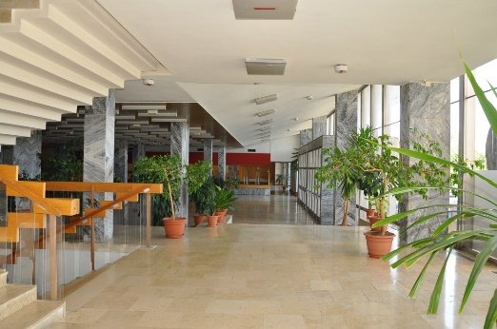
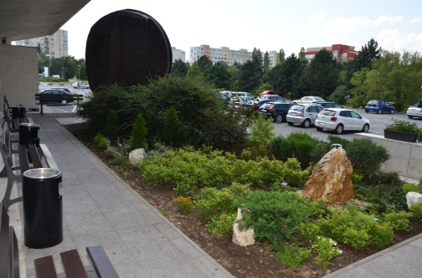
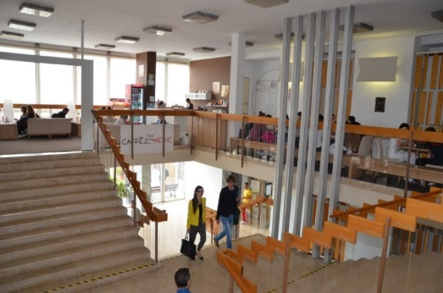
Reasons why the students are choosing our university:
Tradition and history of university education since 17th century and grades recognized all around the world
Quality of education combining traditional and modern methods as well as extensive clinical praxis in hospitals
The city of students offering a lot of opportunities in social, cultural and sport activities Košice: - European Capital of Culture 2013 - European City of Sport 2016 - Peace marathon (95th in 2018, October 07, 2018) - UNESCO Creative City of Media Arts …

Slide 4
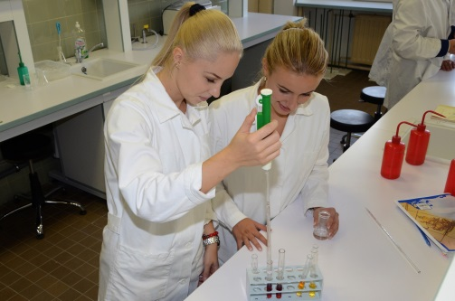
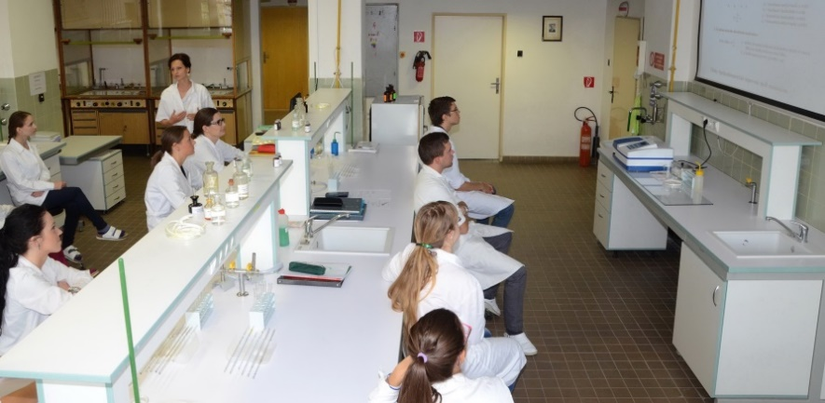
Good teaching and learning is rewarded
Regular rector’s prices - best students at the University
Regular dean’s prices - best students at the Faculty
Support (financial, personal and technological) of the best students’ research works, including student grant scheme, students’ mobility …

Slide 5
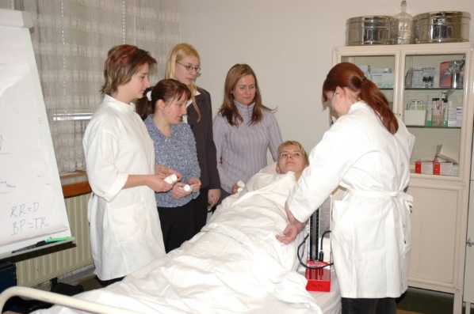
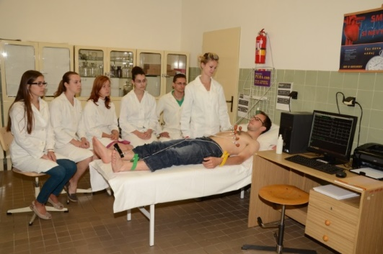
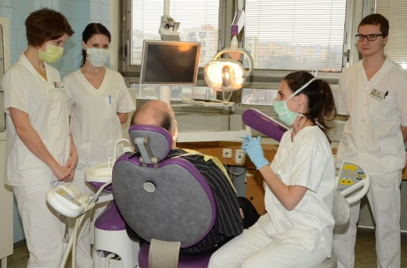
Teaching medicine and health care
Currently, all the bachelor, master and doctoral study forms are realized directly in clinical conditions thanks to the intensive cooperation with 12 hospitals and health care institutions acting in the city.

Slide 6
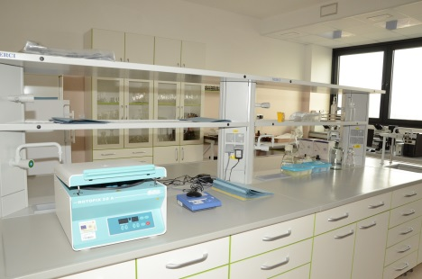
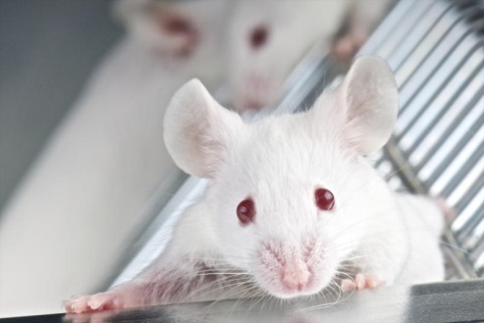
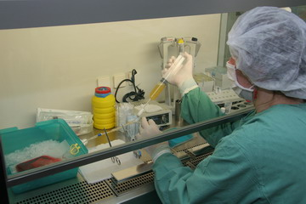
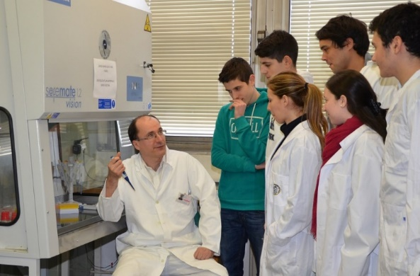
Best didactic trainings
Definitely, well balanced combination of theory and clinical praxis supported by modern multimedia and simulation tools with emphasis on student centered approach.
- bed-side teaching
- possibilities to join research teams during study

Slide 7
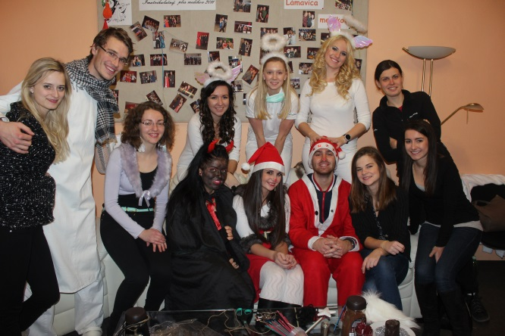
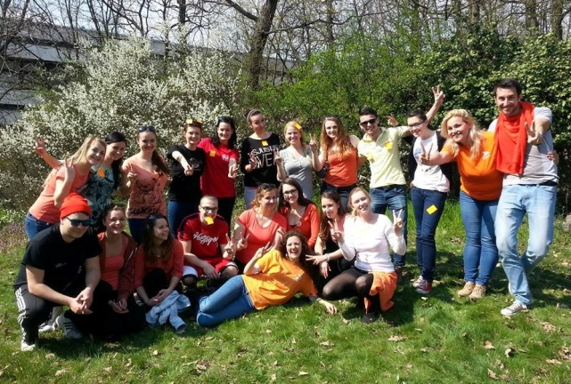
Students life:
SMMK, http://www.spolokmedikovke.sk
SSSZL, https://ssszl.sk

Slide 8
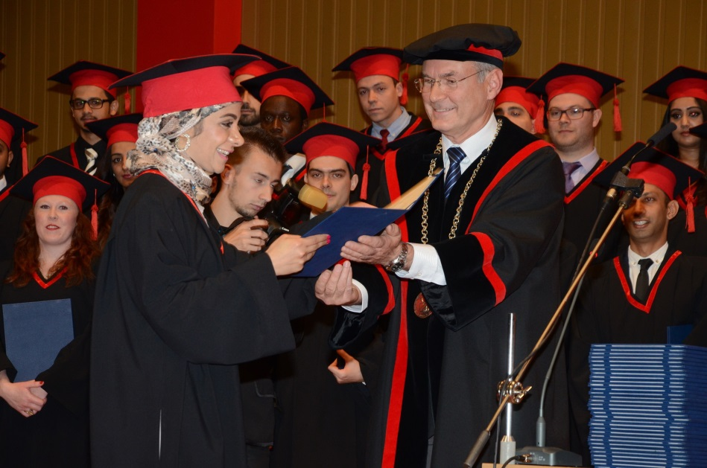
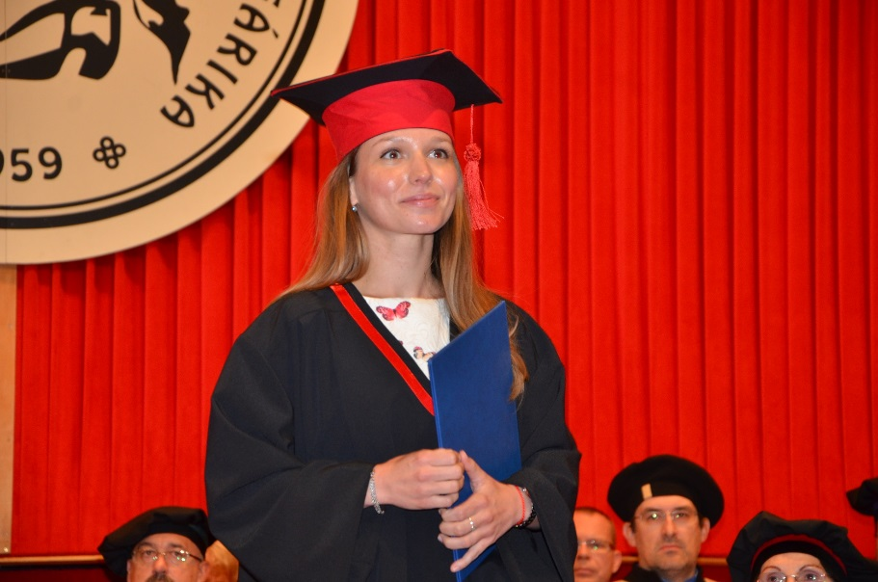
More information:
www.medic.upjs.sk
Thanks for your attention.

